Slide 1


CHAT SYSTEM

Slide 2


TEAM MEMBERS
Himanshu Kumar Singh
Rohan Chauhan
Prakhar Jain
Pruthvi Raj
Rishi Aslaliya

Slide 3
Motivation and Problem Statement
The evolution of the internet technologies had benefit people to accessing to the web easily. More and more services provide by this internet All of this can be virtualize thank to the technologies. Communication between people using the internet becomes part of their daily life. People used to communicate with each other’s using the online chat system to transfer their messages. Traditionally, when people need to communicate with others they will have a face to face conversation to deliver the message, same goes to the education field. It is strongly encourage that student seeking for academic assistance from the lecturer when they face difficulties. Most often happening is when the exam are in the corner and or assignment due date. The traditional way to have a consultation is student make an email appointment with the lecturer and the lecturer accepted the appointment or lecturer is free and available at his room or lecturer consultation hour. However, this communication solution might be not convenient and not efficient due to some issue that happen before the consultation started. The consultation session can be realized in another similar way using an online solution.
There are few issue might be arise when the student want to have consultation with the lecturer using the traditional method which is making appointment and meet at a lecturer room to having the communication.

Slide 4
Student or lecturer are not available in the school
Sometime, the lecturer and student might have some personal issue and cannot come to school. For example the lecturer has to outstation for some important works and the outstation will take a period of time. Also student cannot come to school because they are not available in the area that near to the school. During this period of time, if a student wanted to have a consultation session with their teacher, they cannot meet the respective teacher in the university which causes the student delay their studies progress.
Bunch of email have to filter
Most often lecturer mailbox will be full of emails. Lecturer have to manually filter out which emails is regarding the consultation requests. It will require the lecturer efforts in filtering the emails. In the filtering process, lecturer might be missed out the emails regarding the consultation.
Queue issue regarding the appointment
Sometime human error can be easily made by the lecturer when scheduled the consultation session. The lecturer need to be extremely caution when scheduled the consultation session. It is possible lecturer forget and scheduled two consultation session at the same time. If it is happen, two students will came at the same time. Based on first come first serve, the second student has to wait for the first student to finish his consultation session then finally his turn. It is possible the second student have to wait for a longer time if the first student requires lot of times with the lecturer.
Fail to recall about the consultation
It is human nature that forgets some stuff from time to time. It is possible that either student or lecturer have totally forgotten about the consultation. If it is happen, these will caused another parties to wasting time and wait. Besides that, it is possible that either student or lecturer have forgotten what is the context or topic will be discuss in the later appointment. This is because student or lecturer has totally forgotten about there will be a consultation session later.
Therefore, the above issue can be enhanced using an online consultation solution.

Slide 5
Abstract
This project will be developed in web based. The project is planned to introduce an online web chat system solution for the student and lecturer. The project included an appointment system that will be handling all the appointment between the student and the teacher effectively. Furthermore, a real time communication chat system will be included as the feature in the project to make a face to face communication channel between the student and the teacher. There are additional feature included in the project such as the screen sharing that share the current screen of the user, file sharing and text chat. Besides that, a SMS reminder system will be developed to inform the student or teacher about they will having the consultation session later. However, the real time communication web application will not be cover on the mobile site.

Slide 6
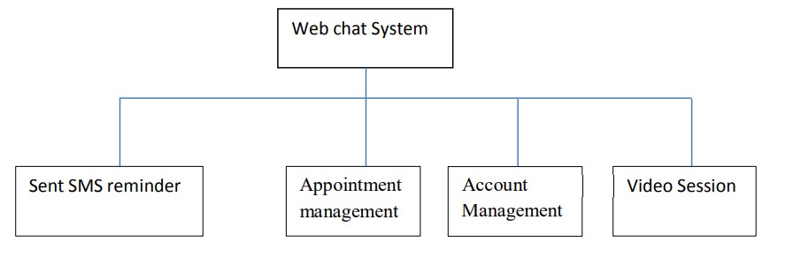
Project approach

Slide 7
Appointment management
The system enable user to make an appointment. If the user is a student, he or she only able to make an appointment with the lecturer. In similar way, if the user is a lecturer, he or she only able to make the appointment with the student. Furthermore, the user can view the detail and time for the appointment. Besides that, the user able to delete the appointment that has been made previously. Moreover, the user also able to accept or decline the appointment that has been requested. Next, the user also can view the appointment that have been rejected and delete the appointment.
Sent SMS reminder
Web chat System Sent SMS reminder Appointment management Account Video Session Management The system will automatically schedule an SMS after the appointment have been accepted by the user. The system will sent the SMS reminder to remind the both student and lecturer that a consultation session will be held later.
Video Session
The system enabled the user to have a video conferencing and text chat with another user. Moreover, the system also allowed the user to share his current computer screen with another user. Next, the system also allowed the user to share the file with another user.
Account Management
The system allowed the user to register and create an account to login into the system. If the user wanted to edit the information of the account, the system allowed the user update the account information. The systems also enabled the user the change the old password to a new password but the user must able to enter the old password correctly for the confirmation.

Slide 8
Preferred model for the project
SCRUM(AGILE FRAMEWORK)

Slide 9
WHY SCRUM??
As we know our project and approaches are complex.
We can address complex adaptive problem while productivity and creativity of delivering product is at highest possible values
By using scrum we can use iterative process for our project.

Slide 10
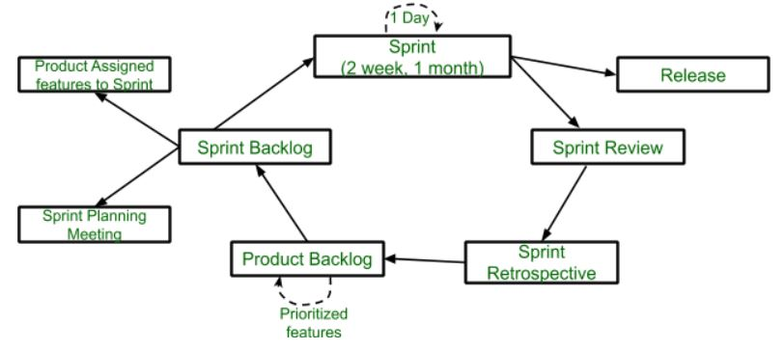
Features of scrum
Scrum is light-weighted framework
Scrum emphasizes self-organization
Scrum is simple to understand
Scrum framework help the team to work together

Slide 11
Scrum framework is fast moving and money efficient.
Scrum framework works by dividing the large product into small sub-products. It’s like a divide and conquer strategy
In Scrum customer satisfaction is very important.
Scrum is adaptive in nature because it have short sprint.
As Scrum framework rely on constant feedback therefore the quality of product increases in less amount of time
These all are the advantage and features we get while using scrum model respective to our project. Which makes scrum model more preferrable for the concern project.

Slide 12
THANK YOU

